Slide 1
Multiple Regression: Regression with Multiple Predictors (Inputs)

Slide 2
Variable selection
In modeling, this is sometimes called “feature selection”
If we are going to allow multiple predictors (inputs), the next question that might arise is how do I decide which inputs should be allowed to predict a particular output?
There are multiple methods of variable selection related to different techniques we will cover, so we will cover variable selection later in the course
Until then, when I give you multiple variable to use in a model, you can assume all the inputs are needed for the model

Slide 3
Example 1: Housing 2
Download housing2.csv from Blackboard
Housing2 consists of another set of real estate data. The goal is to predict house “SalePrice” using the columns: “Age”, “Lotsize”, and “SqFt”
Age is the age of the house in years
Lotsize is the size of the lot the house sits in acres
SqFt is the house square footage

Slide 4
Read in and view file
house2 <-read.csv("C:/Users/hbrown11/Desktop/housing2.csv", header=TRUE)
head(house2)
SqFt Age Lotsize SalePrice
1 1100 15 0.43 49600
2 1300 4 0.68 41700
3 1330 3 0.39 114500
4 1810 1 0.20 185000
5 3500 13 0.33 203100
6 800 4 2.08 73000
The highlighted portion will need to be customized to where you store your file

Slide 5
R Code For 5-fold cross-validation
#install.packages("caret")
set.seed(42)
train_control <- trainControl(method = "cv",number = 5)
model <- train(SalePrice ~., data = house2, method = "lm", trControl = train_control)
#model <- train(SalePrice ~Age+Lotsize+SqFt, data = house2, method = "lm", trControl = train_control)
Notice there are two ways the model can be specified in R:
SalePrice ~. The . tells R to use all other columns in the table as predictors of SalePrice
or
SalePrice ~Age+Lotsize+SqFt which tells R exactly which columns to use
Either is correct to use. SalePrice~. is faster “shortcut” to type, but be careful about using this for every regression problem…if you have extra columns that should not be used in the model, such as an ID column, you cannot use this shortcut.

Slide 6

Interpreting the results
print(model)
The same metrics are used for multiple regression. RMSE Rsquared and MAE are calculated for the out of sample data (not used to build the model). Once again, these measures are relative, and depend on business context to conclude if the model is valuable. These metrics also can be used to compare potential models.

Slide 7
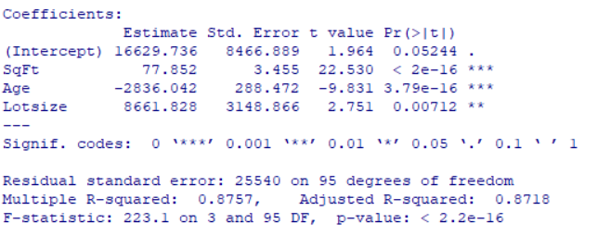
View the model that was constructed
summary(model)
SalePrice=16629.736+77.852*SqFt-2836.042*Age+8661.828*Lotsize
This equation can be used to plug in values for square footage, age, and lot size, to predict house sale price.
The model was highly significant p-value of
2.2x10-16 = 0.000000000000000022

Slide 8

Use the model to make a prediction
If we wanted to make a prediction for a square footage of 1400, a 4 year old house, on a 0.5 acre lot the following could be used (with 95% prediction intervals)
regmodel<-lm(SalePrice~.,data=house2)
summary(house2) #to see max and min of inputs
newdata=data.frame(SqFt=1400,Age=4,Lotsize=.5)
predict(regmodel,newdata=newdata,interval="prediction",level=0.95)
The predicted house sale price is $118,609. We are 95% confidence it will be between $67,3478 to $169,871

Slide 9
Full Program
house2 <-read.csv("C:/Users/hbrown11/Desktop/housing2.csv", header=TRUE)
head(house2)
#install.packages("caret") #only needs to be ran once
library(caret)
set.seed(42)
train_control <- trainControl(method = "cv",number = 5)
model <- train(SalePrice ~., data = house2, method = "lm", trControl = train_control)
print(model)
summary(model)
regmodel<-lm(SalePrice~.,data=house2)
summary(house2) #to see max and min of inputs
newdata=data.frame(SqFt=1400,Age=4,Lotsize=.5)
predict(regmodel,newdata=newdata,interval="prediction",level=0.95)

Slide 10
Relevant Output

Slide 11
Discussion of Results
A predictive model using ordinary least squares linear regression was built to predict house sale price using square footage, house age, and lot size
The model may be written as
SalePrice=16629.736+77.852*SqFt-2836.042*Age+8661.828*Lotsize
It is valid for square footages from 790 to 5800; ages from 1 to 42; and lot sizes from 0.03 to 3.52.
The model was highly significant (p-value <0.0001)
For out of sample predictions, the RMSE is 26834, the R-Square is 0.96, and the MAE is 21467. On average, we can expect a prediction made by this model to be wrong by $21,467.

Slide 12

Aside: Comparing models
If we only use square footage for these data:
set.seed(42)
train_control <- trainControl(method = "cv",number = 5)
model <- train(SalePrice ~SqFt, data = house2, method = "lm", trControl = train_control)
print(model)
Compared to using all three inputs, the three-input model is much better:

